Slide 1


Multi-Stakeholder Models
Internet Governance
Sébastien Bachollet
ICANN Board of Directors
Kiev, Ukraine, 28 September 2012
1
Notes:
1

Slide 2
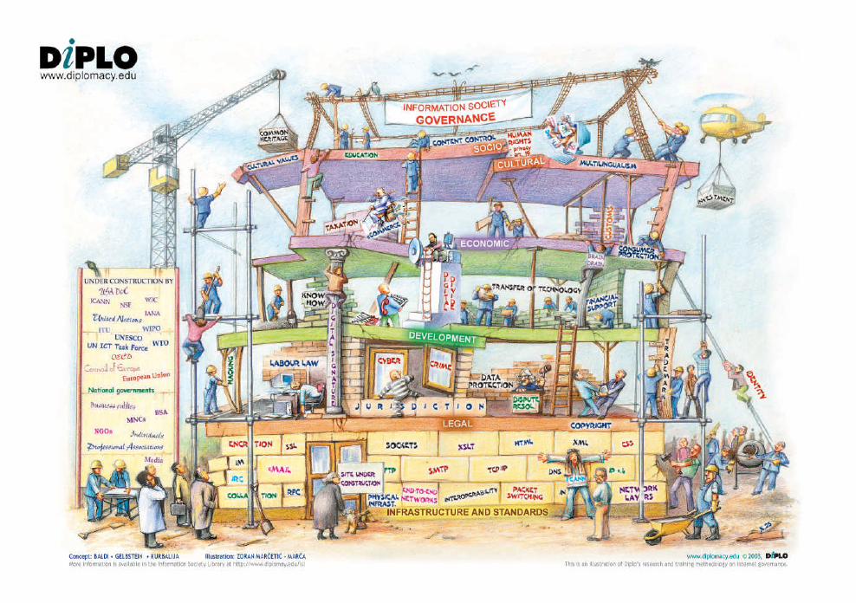

Slide 3
The Internet
Technology developed since the 1960s
Technical specifications:
  Internet Engineering Task Force (IETF)
  Multi-stakeholder development
Distributed system
  Network of networks
  No single owner of the Internet
Dynamic Naming System (DNS) since 1980s
  A hierarchy of name servers with one single Root
  Fully distributed around the world

Slide 4
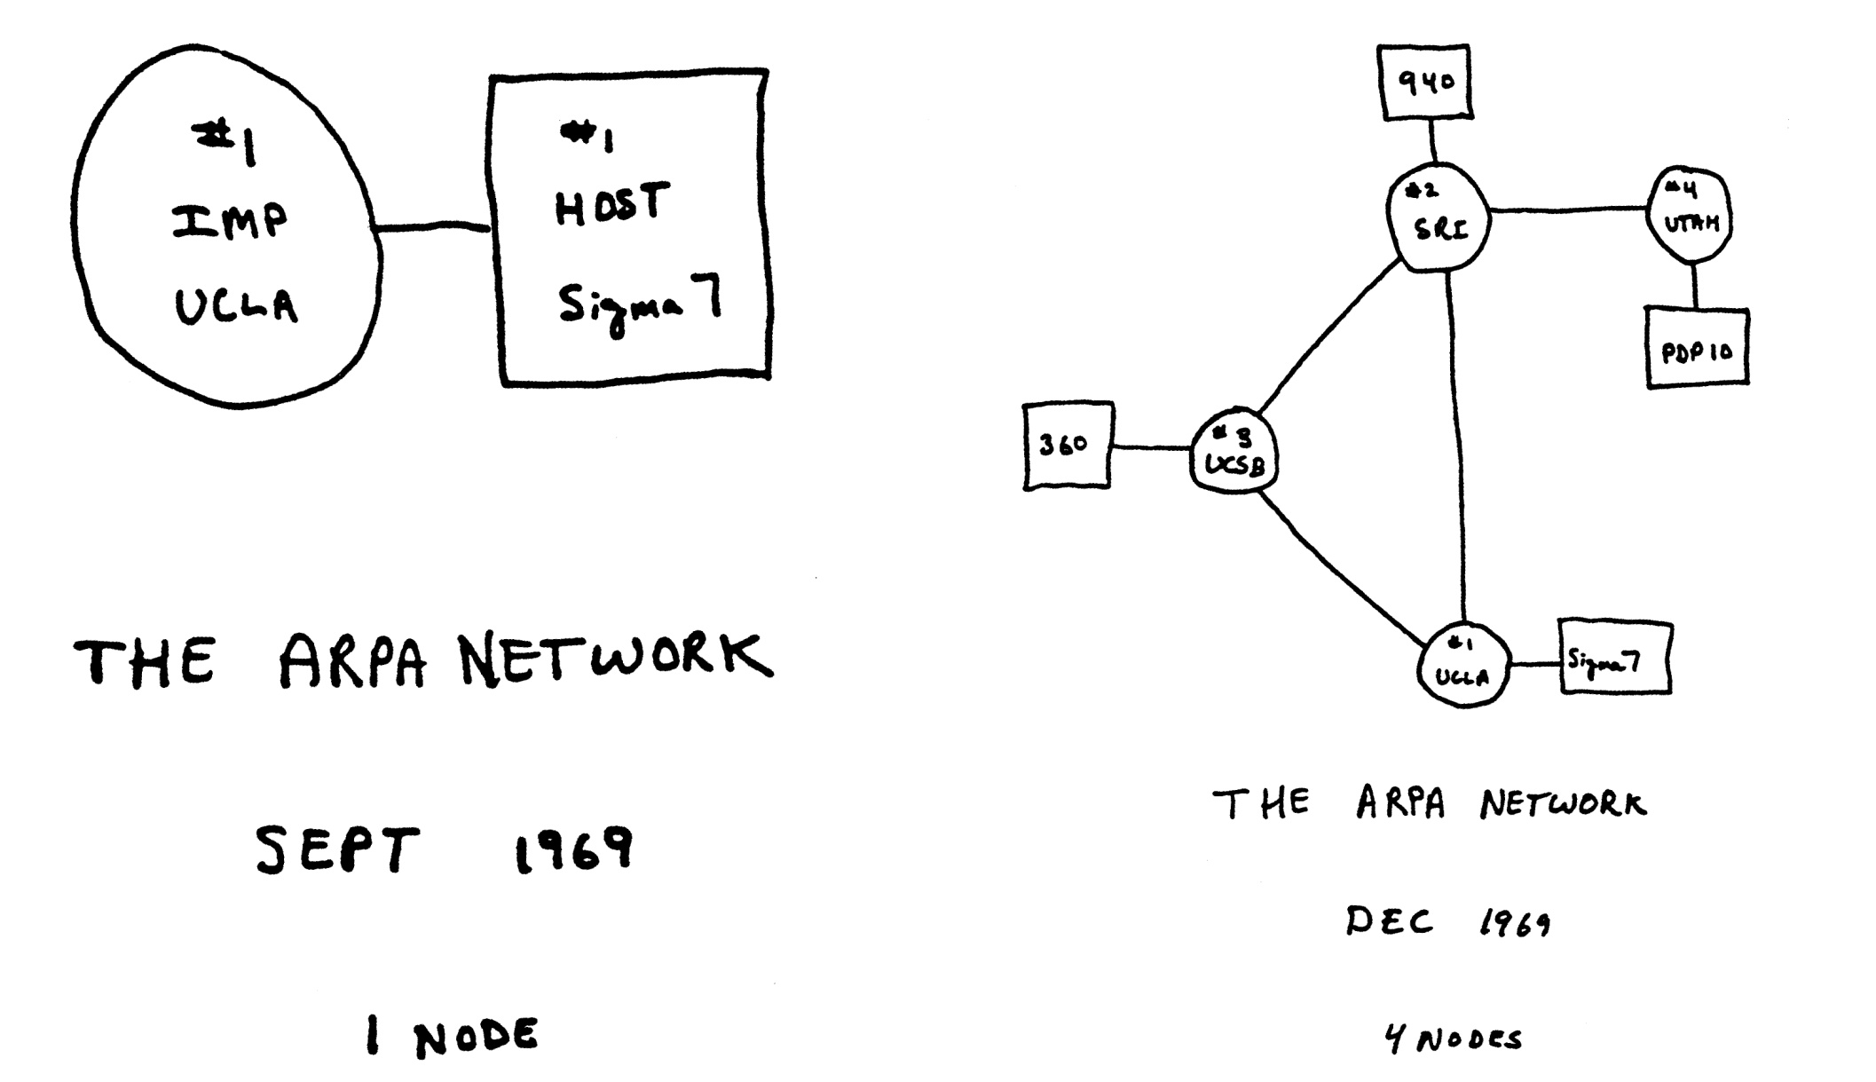
Self-management of these resources has allowed the global Internet to grow from this…

Slide 5
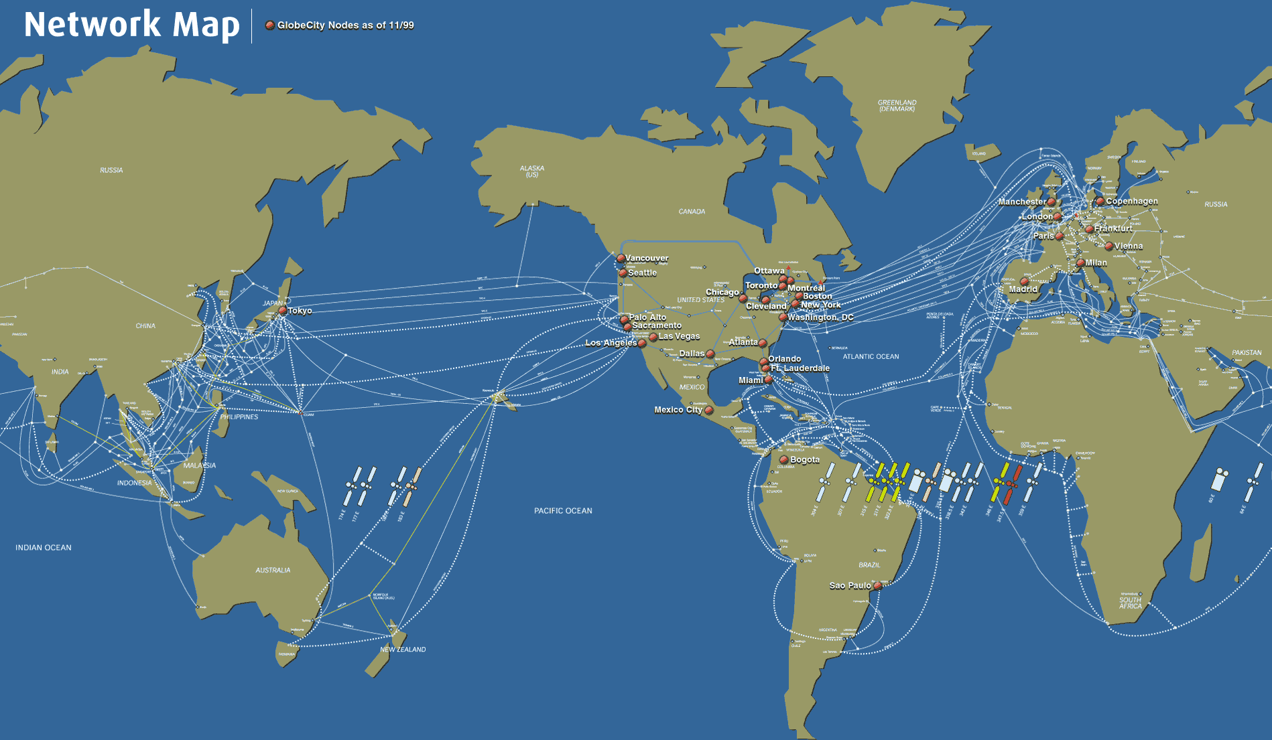
To this…

Slide 6

And, eventually, to this…
This image is a mathematical map of Internet routing in 2002. The colors highlight the geographical and commercial distribution of the Internet's various networks.

Slide 7
Internet - An Evolving Ecosystem
What’s next?
2000+
Social Media, Apps, Mobile Internet and more
VoIP/TV
Blogs
Social Networking
1990+
Music/Images/Video
Search Engines
Wireless Connectivity
1991
World Wide Web
1972
E-mail
1969
Arpanet
Notes:
1969 and 1972 is when we first started seeing the beginnings of the internet with the Arpanet and email.
By 1991 we had the world wide web. Remember first e-mail address?
‘90s brought wireless connectivity. That’s when search engines started coming into play. Yahoo was founded in 1995; Google was
founded in 1998. It’s when we first started seeing the first bits of social networking and blogs started coming on – sharing of music and images over the internet.
2000s, that’s when social media is really kicking up with Facebook and Twitter. We’re starting to see people be able to access the internet on their phones and Voice over IP, which are things like Skype.

Slide 8
What is Multi-stakeholder
An environment where decisions are taken in concertation with
  Governments
  Businesses
  Civil Society
  Individual users
  Any other stakeholder not covered by the above

Slide 9
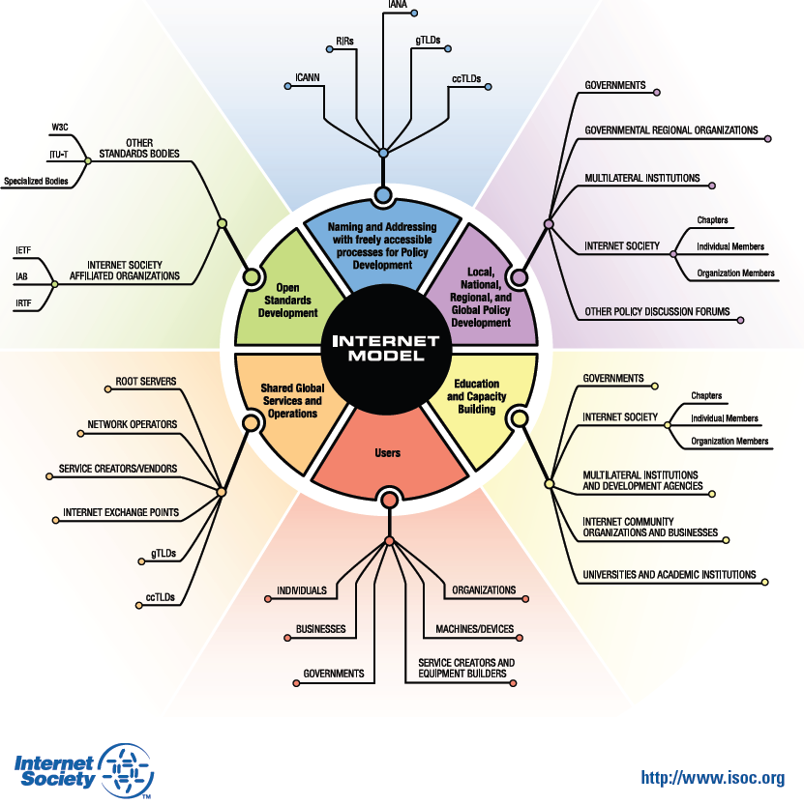
Source: http://www.isoc.org/pubpolpillar/docs/internetmodel.pdf

Slide 10
The Internet Ecosystem
ISOC; outreach, training, promoting open use and development of the Internet for all
IETF; internet technical standards
W3C; World Wide Web Consortium; develops web standards
IGF; multistakeholder ( civil society, technical communities and governments) can discuss public policy aspects of the Internet
ICANN has a narrow technical mandate in a broad and vibrant ecology

Slide 11
ICANN
International Corporation for Addresses, Names and Numbers
  Founded in 1998
  Not-for-profit public-benefit corporation with participants from all over the world dedicated to keeping the Internet secure, stable and interoperable. It promotes competition and develops policy on the Internet’s unique identifiers:
    Domain Names
    IP Addresses
  Took over these functions from the US Government

Slide 12

ICANN multi-stakeholder model
V2
Ombudsman
Board of Directors
Chair
GAC
Governmental
Advisory
Committee
President and CEO
16
9
10
13
14
11
12
1
2
3
4
5
6
7
8
15
L
L
L
L
L
ICANN Staff
MDR – 68
SV – 11
DC – 9
Sydney - 5
Brussels - 5
Other US - 11
Other non-US - 14
Nominating
Committee
Technical
Liaison
Group
Internet
Engineering
Task Force
2011
Per ICANN Bylaws, Article VII, section 2
TLG
IETF
ASO
GNSO
ccNSO
At-Large
Security &
Stability
Advisory
Committee
Root Server
System
Advisory
Committee
Regional Internet Registries
ARIN
RIPE NCC
LACNIC
APNIC
AfriNIC
gTLD Registries gTLD Registrars
IP interests
ISPs
Businesses
Universities
Consumers
ccTLD registries (.us, .uk, .au, .it, .be, .nl, etc.)
Internet Users
(At-Large Advisory Committee,
in conjunction with RALOs)
ALAC
SSAC
RSSAC
Notes:
Article 7, Section 2

Slide 13
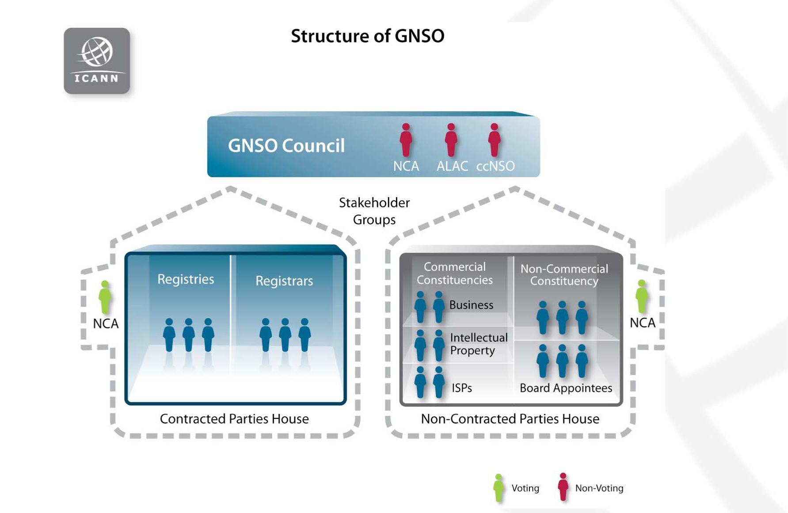
Source: http://gnso.icann.org/meetings/presentation-policy-development-20may10-en.pdf

Slide 14
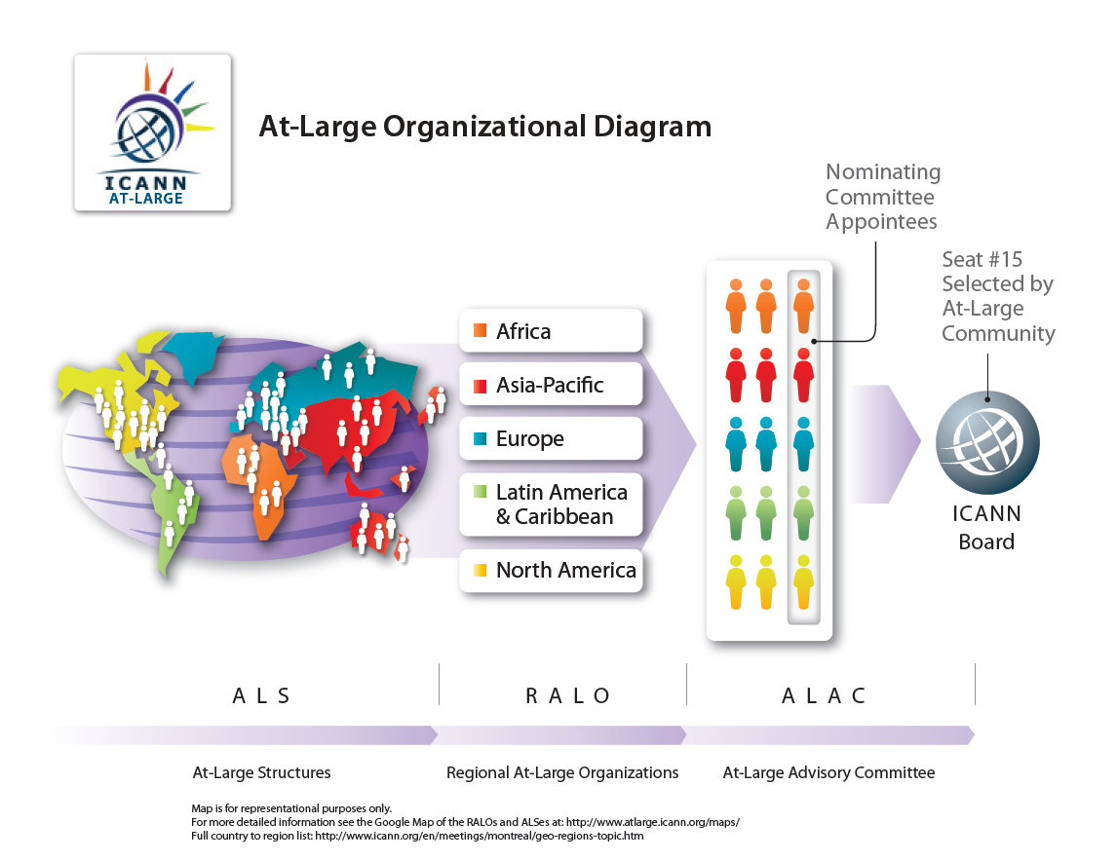
Source: http://www.atlarge.icann.org/orgchart

Slide 15
ICANN’s Nominating Committee Organizational Chart
Chair
Legend
Staff Support
Lead
Chair Elect
Selected by the Board
Non-voting
Staff
Support
Associate Chair
Selected by the Chair
One representative each from the following organizations and committees
5
7
1
1
1
1
ALAC
AF Region
AP Region
EU Region
LAC Region
NA Region
GNSO
Registries Stakeholder Group
Registrars Stakeholder Group
Business Users Constituency (Small)
Business Users Constituency (Large)
Non-Commercial Users Constituency
Internet Service Providers Constituency
Intellectual Property Constituency
ccNSO
ASO
Technical Liaison
Group
IAB for IETF
GAC
RSSAC
SSAC
 | 2012 | 2013 | 2014 | Terms (years)
Board | 3 | 3 | 2 | 3
gNSO | 1 | 2 | 1 | 2
ALAC | 2 (NA-EU) | 3 (AF-AP-LAC) | 2 (NA-EU) | 2
ccNSO | 1 | 1 | 1 | 3

Slide 16
The ICANN Mission
1. Coordinates the allocation and assignment of the three sets of unique identifiers for the Internet
a. Domain Names (forming a System referred to as “DNS”)
b. Internet Protocol (“IP”) addresses, autonomous system (“AS”) numbers; and
c. Protocol port and parameter numbers
2. Coordinates the operation and evolution of the DNS root name server system
3. Coordinates policy development reasonably and appropriately related to these technical functions

Slide 17
ICANN Participation
ICANN has the support of governments – 107 including all of the G8 and most of the G20 are in the GAC
116 country code registry managers support the ccSNO, and more are joining
140 At-Large Structures (ALS) representing the end-users on around 100 countries
ICANN policies regulate the generic name space, coordinate global addressing, and manage the technical parameters
ICANN is one player in the Internet ecosystem
ICANN needs participation at every level in the multistakeholder structure
Notes:
Indonesia, Saudi Arabia and Turkey not present
Ukraine was ccNSO member 113

Slide 18
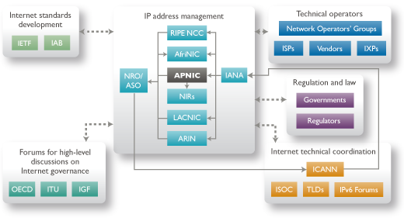
RIR in a model of enhanced, multi-stakeholder coordination to ensure the stability and security of the Internet

Slide 19
International Foundation for
Online Responsibility
Sébastien Bachollet
IFFOR Board member

Slide 20
ICM Registry - .XXX TLD
On 18th March 2011 ICM Registry was granted the .XXX top-level domain
ICM Registry works with a not-for-profit organisation to serve as the policy-making body for the .XXX extension
That organisation is the International Foundation for Online Responsibility (IFFOR)

Slide 21
IFFOR
IFFOR is a ‘not-for-profit’ organization
IFFOR is independent from ICM Registry
IFFOR has its own board of directors
IFFOR is led by an Executive Director
IFFOR has its own policy counsel

Slide 22
IFFOR
The policy counsel consists of
5 Sponsored Community (adult industry)
1 Privacy and Security advocate
1 Free speech advocate
1 Child protection advocate
1 ICM Registry representative

Slide 23

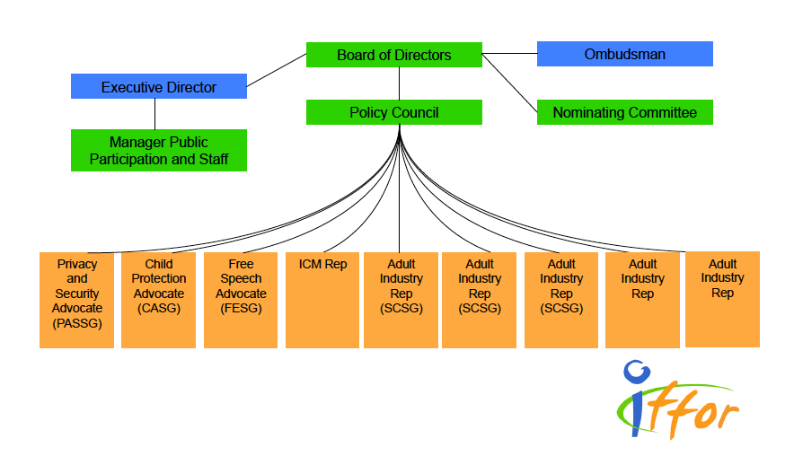
International Foundation for
Online Responsibility

Slide 24
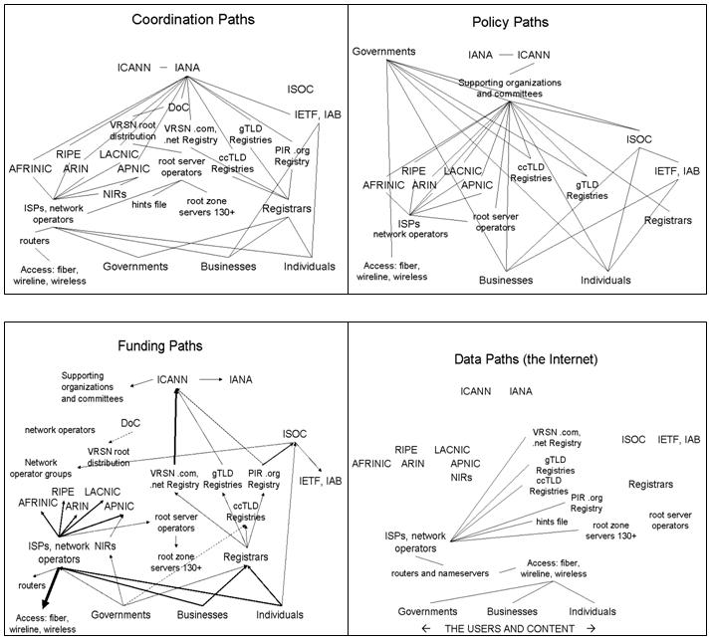
dsmiley.
http://myigf.com/archives/author/dsmiley/

Slide 26






Sébastien Bachollet
    sebastien@bachollet.com
    http://sebastien.bachollet.fr/
ICANN
  Board Member – 2010 – 2014
  Vice-chair ALAC – 2007 – 2010
  Business Constituency – 2001 – 2004
IFFOR
  Board Member – 2011 – 2014
Isoc France
  President d’honneur – 2009 …
  President – 2004 – 2009
    www.isoc.fr
Egeni
  President – 2001 – 2008
Publications
  Des souris et des hommes – 2005
  Géopolitique de l’Internet – 2003

Slide 27
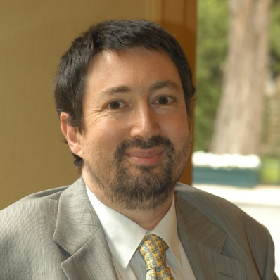

Sébastien Bachollet
ITEMS
  Consultant Manager – SI & gouvernance d’Internet
Gérant Fondateur de BBS – 7 ans
  Consultant SI & gouvernance d’Internet
Cigref – 3 ans
  Délégué Général Adjoint
  International – fournisseurs – gouvernance
SNCF – 8 ans
  Socrate terminaux distribution (GL)
  Stratégie distribution & système (GL)
  DSI adjoint (SNCF)
Air Inter – 5 ans
  Marketing + système distribution

